Slide 1
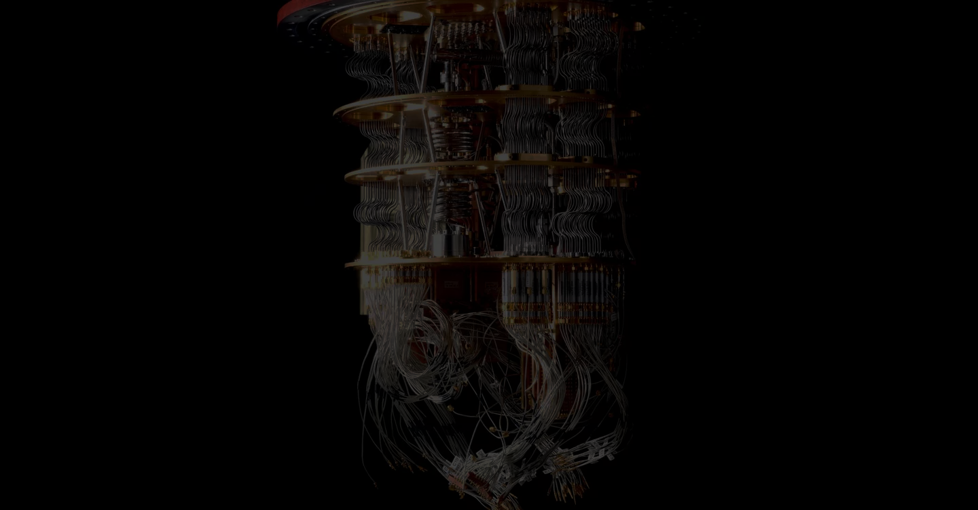
Team Presentation
Team Q-Sight
Mentor | Park Siheon
Leader | Lee Hojun
Teammates | Jang Seoyeon
 | Jin Sumin
 | Cho Gyeongmin
 | Oh yoonju
 | Han Jaehun
Parameterized Quantum Circuit #18

Slide 2
What is PQC?
PQC : Parameterized Quantum Circuit
Why is PQC important?
PQC can be thought as Interface between quantum and classical computers
It was already transpiled, so It is expected to approach NISQ in the near future.
🡪 It will indeed be used in many field(e.g Machine Learning).

Slide 3
How Can we evaluate PQC?
The criteria for evaluating it are
Expressibility & Entangling Capablity
Briefly, Depending on how PQC is constructed, the extent to which areas can be reached in Hilbert space is limited varies.
It is important to minimize the number of parameters, etc. while maximizing the area.

Slide 4
What we did : Our team made…
1. PQC Prototype
2. Algorithm for calculating
the Expressibility and Entangling capability
of the input circuit

Slide 5
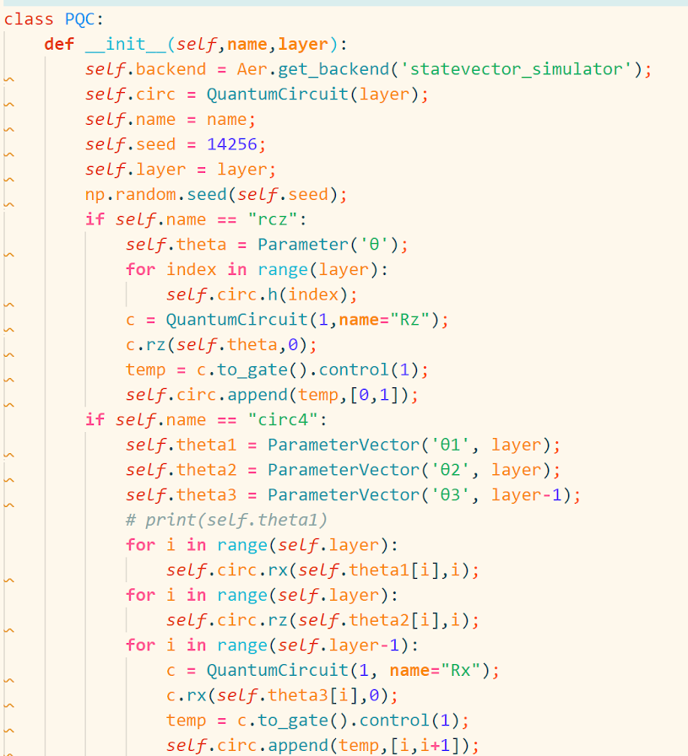
1. PQC Prototype
- PQC Class

Slide 6
1. PQC Prototype (EXPR)
“Expressibility”
Circuit’s ability to generate (pure) states
that are well representative of the Hilbert space.

Slide 7
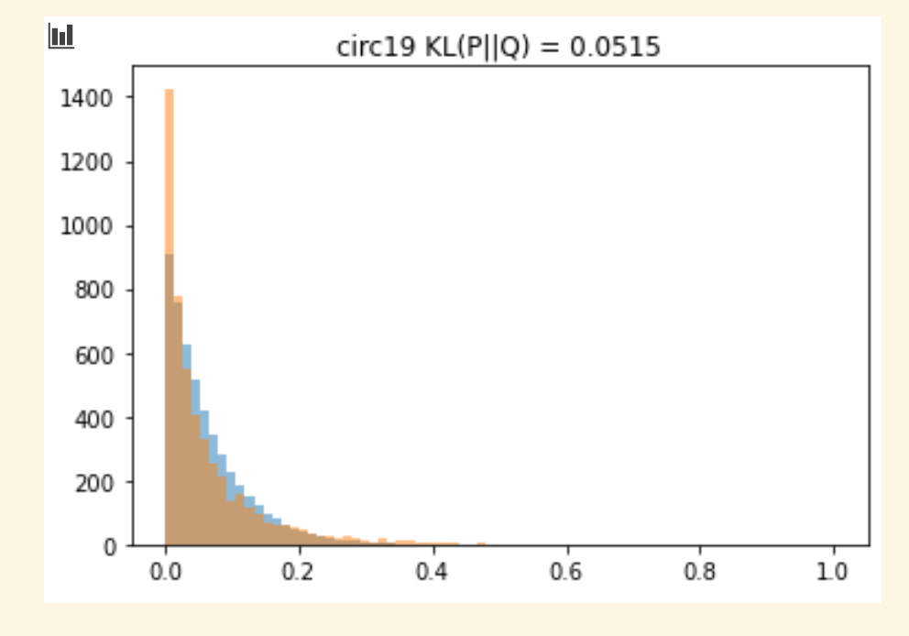
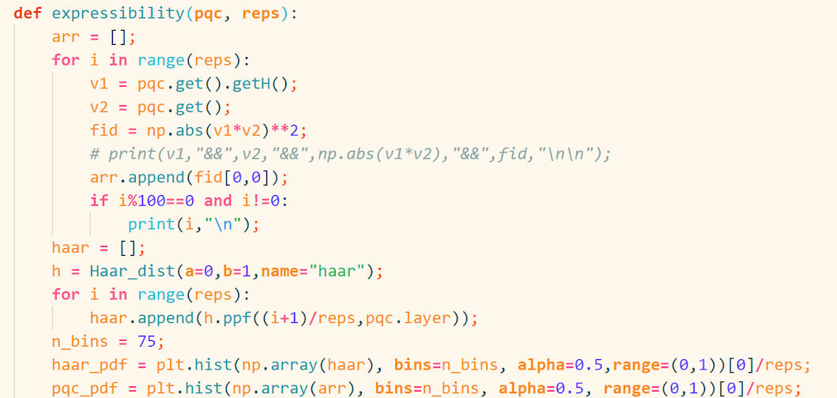
1. PQC Prototype (EXPR)
- Available in layers
Notes:
함수 실행하면 이렇게 그래프가 나오고, expressibility 값을 알 수 있다고 설명해줍시다.
주황색은 PQC distribution, 파란색은 Haar distribution입니다.
히스토그램 간격은 75(논문과 동일)
샘플링 횟수는 5000쌍(총 10000번)

Slide 8
2. PQC Prototype(Ent)
“Entangling Capablity”
Average Meyer-Wallach entanglement of states generated by the circuit

Slide 9
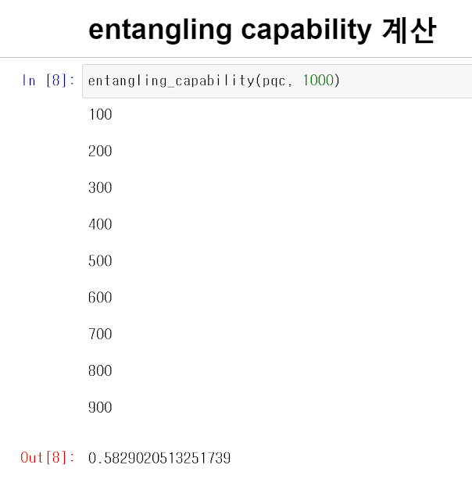
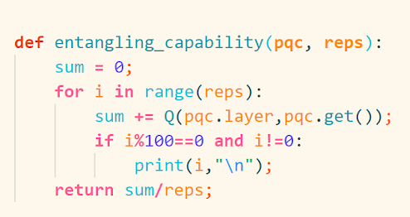
2. PQC Prototype(Ent)
- Available in layers
Notes:
함수 실행하면 이렇게 그래프가 나오고, expressibility 값을 알 수 있다고 설명해줍시다.
주황색은 PQC distribution, 파란색은 Haar distribution입니다.
히스토그램 간격은 75(논문과 동일)
샘플링 횟수는 5000쌍(총 10000번)

Slide 10
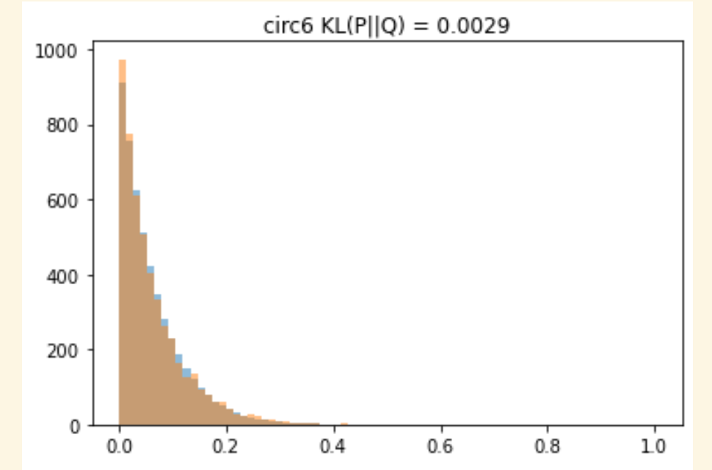
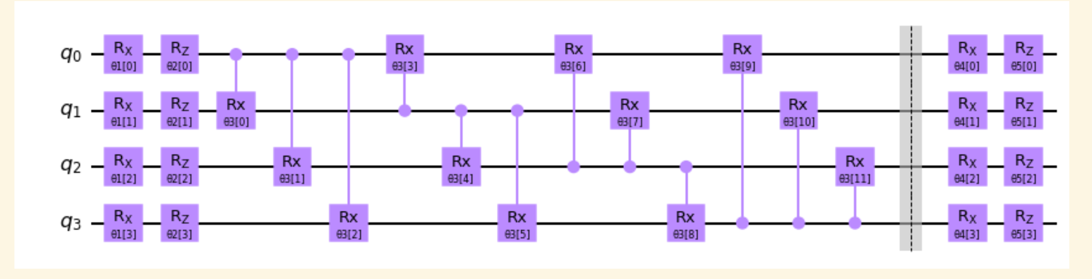
Circuit 6
Entangling capability

Slide 11

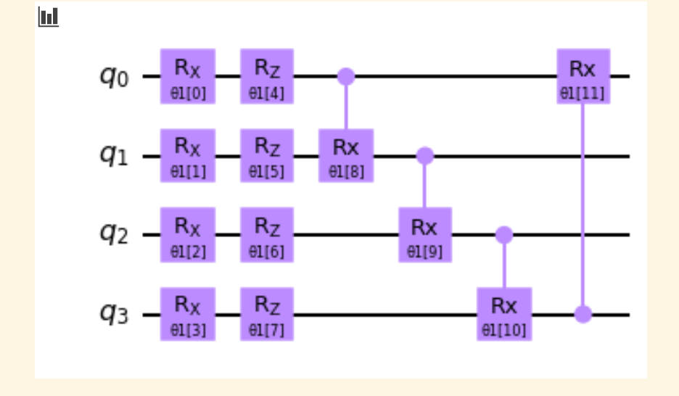
Circuit 19
Entangling capability

Slide 12
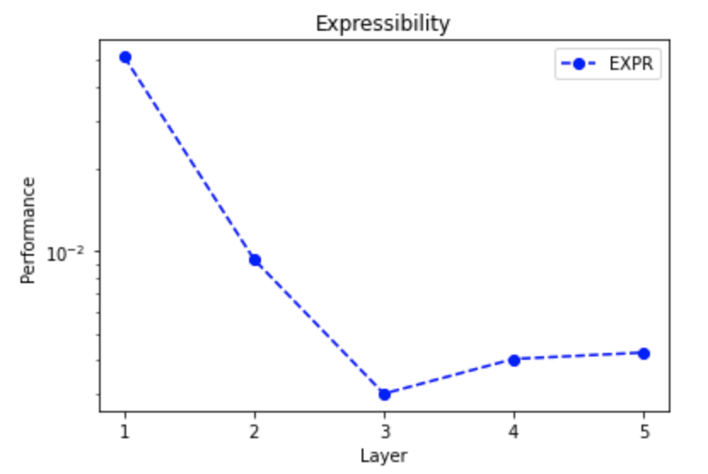
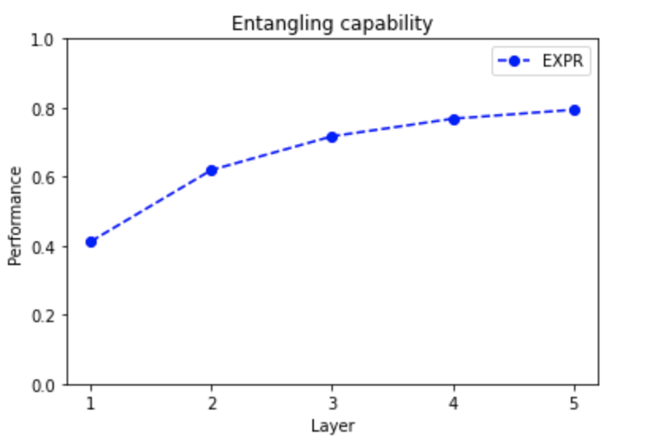
Performance comparison by number of layers
Notes:
circuit 19에 대해 layer 1개~5개일 때의 EXPR,ENT를 그래프로

